Slide 1
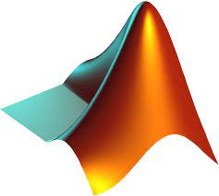

Communication Design
# LAB.5 Wireless Communications
Pulse-Shaping Filters
Ass.Lec.Ammar Alabbassi

Slide 2
Course Outline:
1- Simulate a Basic Digital Communications Link
Implement the essential components of a single-carrier digital communications system, including additive white Gaussian noise.
2- Pulse-Shaping Filters
Incorporate transmit and receive filters into your simulation.
3- Multipath Channels
Model a multipath channel and evaluate the impact on link quality.
4- OFDM
Implement orthogonal frequency-division multiplexing (OFDM), a multicarrier modulation scheme.

Slide 3
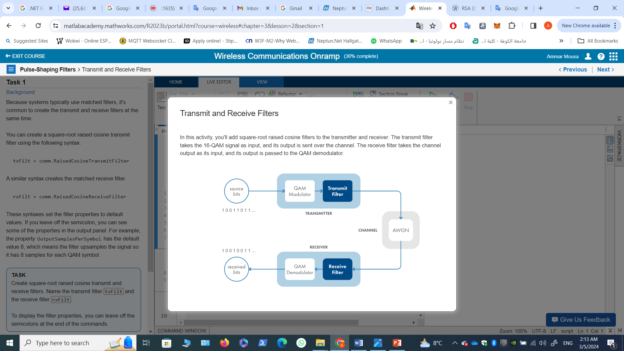
2- Pulse-Shaping Filters
These filters helps in constraining the occupied bandwidth of the waveform without introducing intersymbol interference (ISI).

Slide 4
2- Pulse-Shaping Filters Transmit and Receive Filters

Slide 5
Task 1
This code sets up a 16-QAM link.
% Simulation parameters
numBits = 20000;
modOrder = 16;
% Create source bit sequence and modulate using 16-QAM.
srcBits = randi([0,1],numBits,1);
modOut = qammod(srcBits,modOrder,"InputType","bit","UnitAveragePower",true);

Slide 6
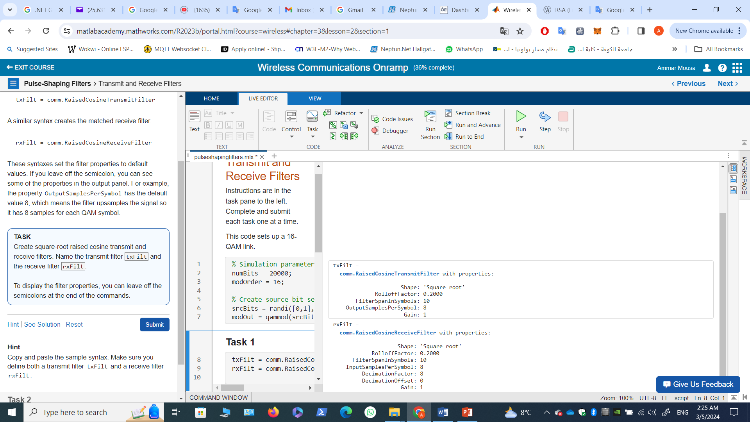
Task 1
Background
Because systems typically use matched filters, it's common to create the transmit and receive filters at the same time.
You can create a square-root raised cosine transmit filter using the following syntax.
txFilt = comm.RaisedCosineTransmitFilter
A similar syntax creates the matched receive filter.
rxFilt = comm.RaisedCosineReceiveFilter
These syntaxes set the filter properties to default values. If you leave off the semicolon, you can see some of the properties in the output panel. For example, the property OutputSamplesPerSymbol has the default value 8, which means the filter upsamples the signal so it has 8 samples for each QAM symbol.
TASK
Create square-root raised cosine transmit and receive filters. Name the transmit filter txFilt and the receive filter rxFilt.
To display the filter properties, you can leave
off the semicolons at the end of the commands.
txFilt = comm.RaisedCosineTransmitFilter
rxFilt = comm.RaisedCosineReceiveFilter

Slide 7
Task 2
To apply the transmit filter to the modulated 16-QAM signal, pass the signal as an input to the stored filter.
sigOut = txFilt(sig)
TASK
Apply the transmit filter txFilt to the modulated 16-QAM signal modOut. Name the output signal txFiltOut.
txFiltOut = txFilt(modOut);

Slide 8
Task 3
Notice that (txFiltOut= 40000) is 8 times longer than (modOut=5000), which is expected given the value of the filter property OutputSamplesPerSymbol.
Next, you want to apply AWGN to the filtered signal. However, the transmit filter changed the signal power.
To scale the noise power appropriately, pass a third input to the awgn function.
sigOut = awgn(sig,SNR,"measured")
When you use the "measured" option, the function calculates the input signal power and scales the noise power based on the signal-to-noise ratio.
TASK
Apply AWGN to the filtered signal txFiltOut. Use a signal-to-noise ratio of 7 dB. Name the output chanOut.
SNR = 7;
chanOut = awgn(txFiltOut,SNR,"measured");

Slide 9
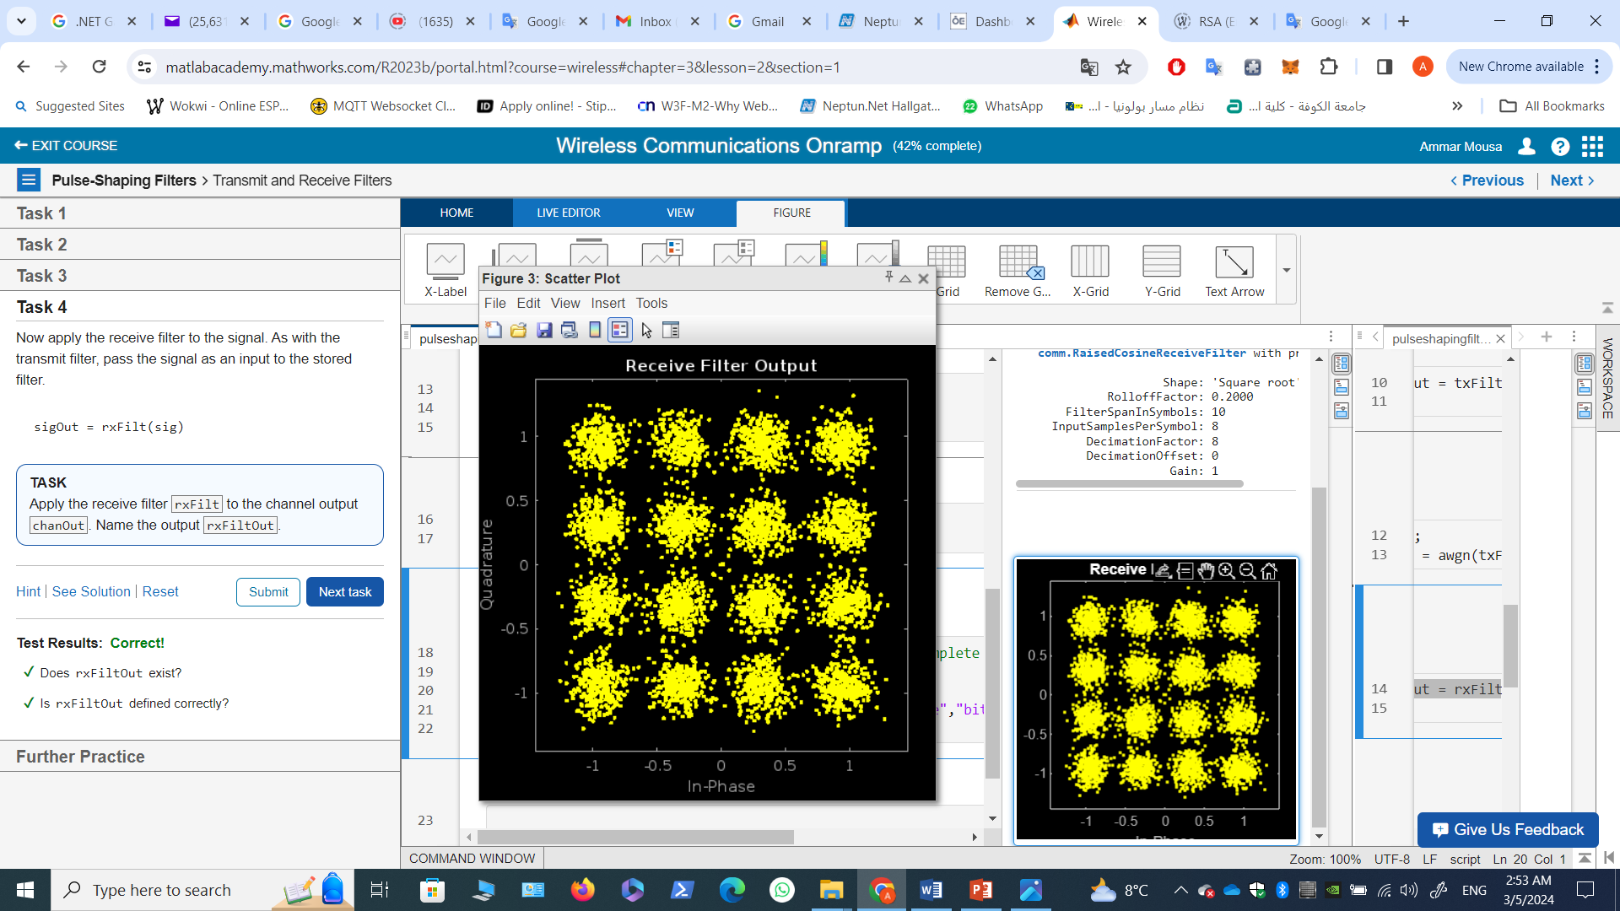
Task 4
Now apply the receive filter to the signal. As with the transmit filter, pass the signal as an input to the stored filter.
sigOut = rxFilt(sig)
TASK
Apply the receive filter rxFilt to the channel output chanOut. Name the output rxFiltOut.
rxFiltOut = rxFilt(chanOut);
Demodulate back into bits. This code only executes after rxFiltOut has been created.
if exist("rxFiltOut","var") % code runs after you complete Task 4
scatterplot(rxFiltOut)
title("Receive Filter Output")
demodOut = qamdemod(rxFiltOut,modOrder,
"OutputType","bit","UnitAveragePower",true);
end
Remember you added more noise to the channel here (SNR of 7 dB) compared to the previous activity (SNR of 15 dB). The receive filter has reduced the noise power by about 8 dB, so the constellation has roughly the same amount of noise as the signal from the previous activity.

Slide 10
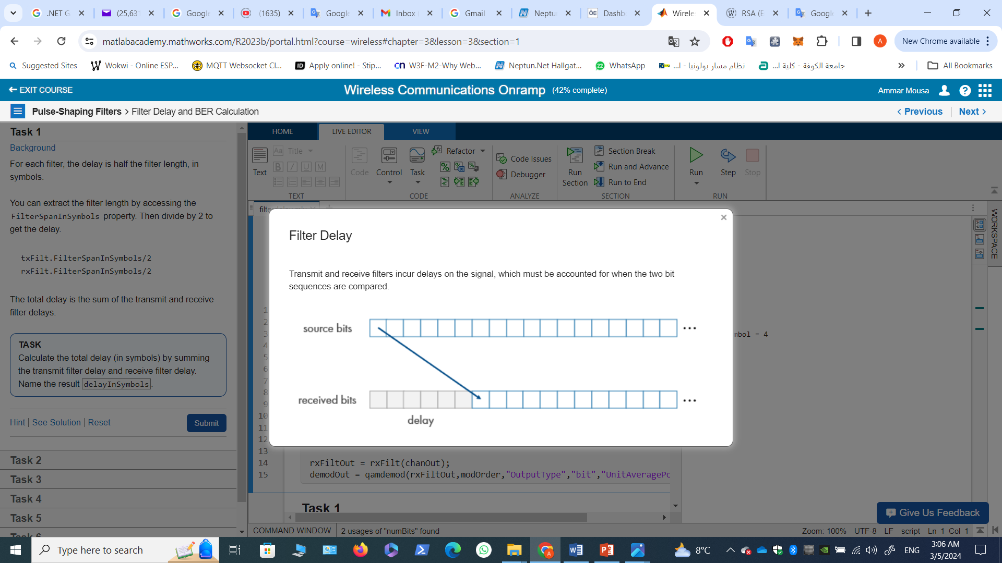
2- Pulse-Shaping Filters

Slide 11
2- Pulse-Shaping Filters Filter Delay and BER Calculation

Slide 12
Task 1
This code simulates a 16-QAM link with filtering and AWGN.
numBits = 20000;
modOrder = 16; % for 16-QAM
bitsPerSymbol = log2(modOrder) % modOrder = 2^bitsPerSymbol
txFilt = comm.RaisedCosineTransmitFilter;
rxFilt = comm.RaisedCosineReceiveFilter;
srcBits = randi([0,1],numBits,1);
modOut = qammod(srcBits,modOrder,"InputType","bit","UnitAveragePower",true);
txFiltOut = txFilt(modOut);
SNR = 7; % dB
chanOut = awgn(txFiltOut,SNR,"measured");
rxFiltOut = rxFilt(chanOut);
demodOut = qamdemod(rxFiltOut,modOrder,"OutputType","bit","UnitAveragePower",true);

Slide 13
Task 1
Background
For each filter, the delay is half the filter length, in symbols.
You can extract the filter length by accessing the FilterSpanInSymbols property. Then divide by 2 to get the delay.
txFilt.FilterSpanInSymbols/2
rxFilt.FilterSpanInSymbols/2
The total delay is the sum of the transmit and receive filter delays.
TASK
Calculate the total delay (in symbols) by summing the transmit filter delay and receive filter delay. Name the result delayInSymbols.
delayInSymbols = rxFilt.FilterSpanInSymbols/2 + txFilt.FilterSpanInSymbols/2
delayInSymbols = 10

Slide 14
Task 2
However, to compare bits, you need to determine the delay in bits, not symbols.
For 16-QAM, four bits are mapped to one symbol. This conversion factor has been stored in the variable bitsPerSymbol, defined in the script.
To convert the delay from symbols to bits, multiply the delay in symbols by bitsPerSymbol.
delayInSymbols * bitsPerSymbol
TASK
Calculate the delay in bits by converting delayInSymbols to bits. Name the result delayInBits.
delayInBits = delayInSymbols * bitsPerSymbol
delayInBits = 40

Slide 15
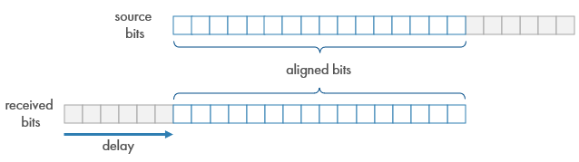
Task 3
Extract Aligned Bits
Now that you know the delay, you're ready to compare bits. To compare the correct bits,
you need to align matching bits from the source bit sequence and the received bit sequence.

Slide 16

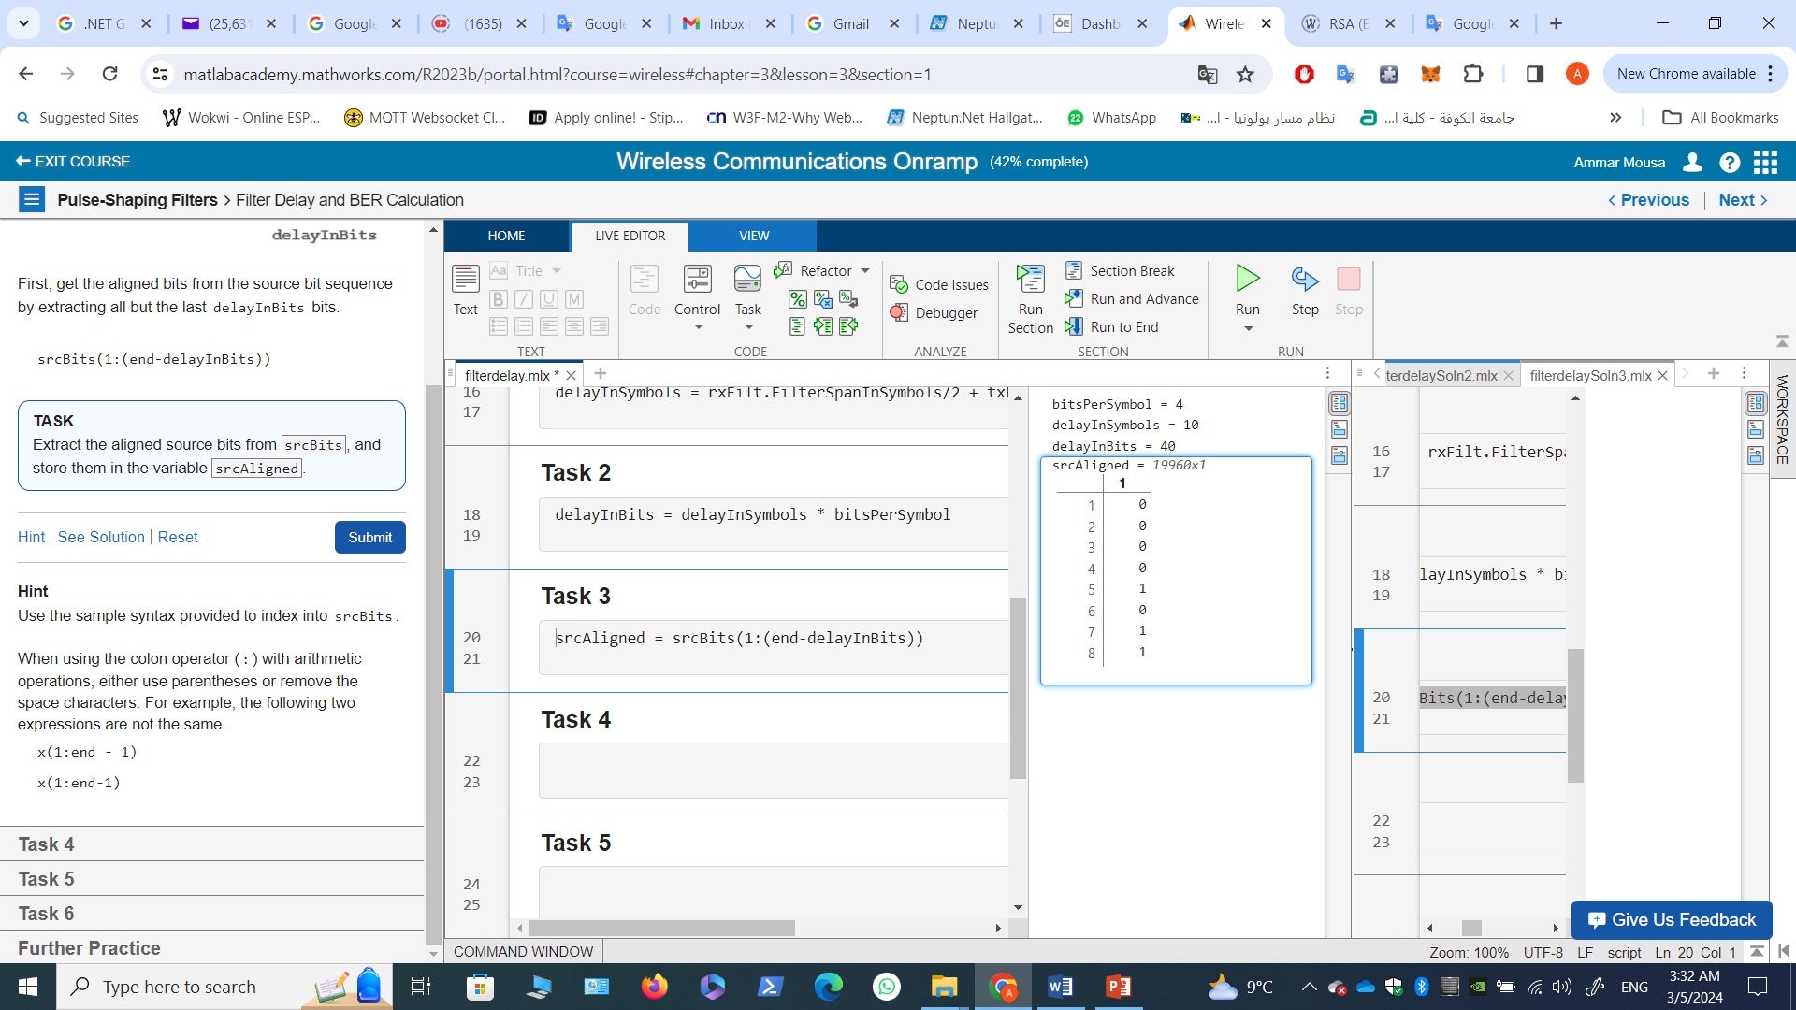
Task 3
Background
First, get the aligned bits from the source bit sequence by extracting all but the last delayInBits bits.
srcBits(1:(end-delayInBits))
TASK
Extract the aligned source bits from srcBits, and store them in the variable srcAligned.
srcAligned = srcBits(1:(end-delayInBits))

Slide 17

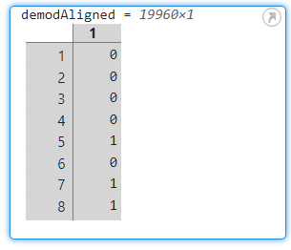
Task 4
Next, get the aligned bits from the received bit sequence by extracting all but the first delayInBits bits.
demodOut((delayInBits+1):end)
TASK
Extract the aligned received bits from demodOut, and store them in the variable demodAligned.
demodAligned = demodOut((delayInBits+1):end)

Slide 18
Task 5
Now you can compare the aligned bits and count the number of bit errors.
Remember you can use the ~= operator to perform a bit-by-bit comparison to find nonmatching bits, and then use nnz to count the bit errors.
nnz(bitSeq1 ~= bitSeq2)
TASK
Count the number of bit errors between srcAligned and demodAligned. Store the result in the variable numBitErrors.
numBitErrors = nnz(srcAligned ~= demodAligned)
numBitErrors = 44

Slide 19
Task 6
The aligned bit stream is shorter than the original.
numAlignedBits = length(srcAligned)
To calculate the bit error rate, you need to divide the number of bit errors by the number of aligned bits.
TASK
Calculate the bit error rate, and store it in the variable BER.
numAlignedBits = length(srcAligned);
BER = numBitErrors/numAlignedBits
BER = 0.0022

